Slide 1
A Hierarchical ReAct Multi-Agent Pipeline for Residential Appliance Load Scheduling Under Dynamic Electricity Pricing
MASTER’S THESIS · UNIVERSITY OF OULU
Can language model agents give households reliable, cost-saving daily appliance recommendations?
Hoan Le · Information Processing Science · Supervisor: Yueqiang Xu
Notes:
Hello, my name is Hoan Le. This is my master’s thesis in Information Processing Science at the University of Oulu, supervised by Yueqiang Xu. The thesis asks whether language model agents can give households reliable, cost-saving advice on when to run their appliances under dynamic electricity prices. I will keep the background short and spend most of the time on what I found, how I found it, and the demo application.

Slide 2
Contents
01
Introduction
Motivation, previous research, research questions
02
Artifact and method
The two-agent pipeline, data and the pre-registered evaluation
03
Results
SQ1 value and cost · SQ2 conditions · SQ3 one agent or two
04
Demonstration
The demo application in screenshots
05
Conclusion
Significance, limitations and future work
Notes:
The talk has five parts. I start with the motivation, the earlier research and my research questions. Then I show the artifact and how I evaluated it. Most of the time goes to the results for my three sub-questions, followed by a look at the demo application, and I finish with what the results mean and what they do not show.

Slide 3
Finnish prices change every 15 minutes
15 min
3.1×
1 in 5
8 kW
price interval for spot-price contracts since October 2025
median ratio of the day’s dearest to cheapest hour, 2023–2026
days with at least one negative-price hour
power-charge threshold; a car and a sauna come close to it
The problem Fitting several appliance cycles to a new price curve every day, under a power limit, is hard by hand. Could an AI assistant do it for any household, in plain language?
Notes:
In Finland, households on spot-price contracts have paid a price that changes every fifteen minutes since October 2025. Prices within a day vary a lot: from 2023 to 2026, the most expensive hour of a day cost a median of 3.1 times the cheapest, and one day in five had at least one hour with a negative price. So running the dishwasher or the washing machine at the right time saves money. Doing it by hand is hard, though, when several appliances must fit the price curve and the household must also stay under a power limit. Network companies may now charge for power above 8 kilowatts, and a home with an electric car and a sauna can come close to it. Could an AI assistant plan this every day, for anyone, in plain language?

Slide 4
LLM energy assistants exist, but are not yet reliable
What earlier LLM systems showed
What this thesis adds
Only 1 of 3 models coordinated all appliances; one test day (El Makroum et al., 2026)
Open problems: coordination, constraint safety; check every schedule (Jonah et al., 2026)
Unclear what an agent adds over Home Assistant rules and EMHASS
An optimiser tool and a verifying harness around the agents
Evaluation over price patterns and loads, on held-out days
Comparison with tools households can already install
RQ How can a hierarchical ReAct multi-agent system (the Multi-Agent Pipeline) be designed to give households reliable, cost-saving daily appliance recommendations under dynamic electricity prices?
SQ1 What do the pipeline’s recommendations save, how often are they valid, and what do they cost, compared with a base LLM without tools?
SQ2 Under which price patterns and household loads do they save at least as much as existing home energy management tools?
SQ3 Does dividing the work between two agents make them more reliable, cheaper or faster than a single agent?
Notes:
Language models have recently been tried for exactly this. In the first home energy management systems built on large language models, agents schedule the appliances. But the published systems have clear limits. In the hierarchical multi-agent system of El Makroum and colleagues, only one of three models coordinated all appliances, and the evaluation covered a single day. Jonah and colleagues list coordination failures, untested constraint safety and short evaluations as open problems, and recommend that every schedule be checked before it runs. It is also unclear what an agent adds over tools households can already install, such as a cheapest-hours automation in Home Assistant or the open-source optimiser EMHASS. This leads to my research question: how can a hierarchical ReAct multi-agent system be designed to give households reliable, cost-saving daily recommendations? Sub-question one asks what the recommendations save and cost compared with a base language model without tools. Sub-question two asks under which price patterns and household loads they save at least as much as existing tools. And sub-question three asks whether dividing the work between two agents helps at all, compared with a single agent.

Slide 5







The artifact: two agents inside a deterministic harness
Built with LangGraph over 14 Design Science Research iterations, from four agents to two
Deterministic harness (no language model)
Orchestrator
LLM agent: brief
check fails: feedback round (max 2)
Daily plan
Scheduler
verify_schedule()
Plan
appliances, windows
LLM agent, ReAct loop
windows · 8 kW
times + explanation
then the Orchestrator explains the verified plan
profile_data()
+ 2 solved days (RAG)
Tools
prices · MILP optimiser
Green: language model agent · White: deterministic code · Variant for SQ3: a single agent plays both roles in the same harness
Notes:
This is the final artifact, built with LangGraph following Design Science Research: over fourteen build-and-evaluate iterations it went from four agents to two, as fixed procedures moved out of the agents into deterministic code. A household’s plan for the day goes in: which appliances to run, when each is ready, and when it must finish. The Orchestrator agent reads the plan and briefs the Scheduler. Around the agents sits a deterministic harness, shown in grey, with no language model in it. It profiles the appliances from the household data and retrieves two similar solved days as worked examples. The Scheduler agent works in a ReAct loop of thought, action and observation. It reads the day’s prices and calls an optimiser tool, a mixed-integer program that finds the cheapest start times within the windows and the 8 kilowatt limit. The harness then verifies the schedule: every appliance present, every start inside its window, the peak under the limit. If a check fails, the problem goes back to the Scheduler for one more round. Finally, the Orchestrator explains the result to the household. For comparison, I also built a single agent that does both roles inside the same harness.

Slide 6
Evaluation on 72 held-out days, pre-registered
Data
Design of the test
Compared with
REFIT appliance cycles from 18 UK homes
Finnish Nord Pool prices, 15-minute
4 price patterns × 3 loads
Electrified: + 3.7 kW car, + 6.8 kW sauna
9 hypotheses registered before the run
Held-out set Q3: 72 days never used in design
GPT-6 Luna, 3 runs per day
Wilcoxon, TOST, Mann–Whitney; Holm
Exact optimum (MILP), upper bound
Base LLM without tools
Cheapest window; HA cheapest hours
EMHASS optimiser; smart timer
Primary outcome saving against starting every appliance when ready; a plan that breaks a window or the 8 kW limit is invalid and saves nothing
Notes:
To evaluate the design I needed realistic days. The appliance cycles come from the REFIT dataset: real washing-machine, dishwasher and tumble-dryer cycles measured in eighteen UK homes. The prices are real Finnish Nord Pool prices at fifteen-minute resolution. Each day combines one of four price patterns, stable, volatile, a price spike or negative prices, with one of three household loads: light, heavy, and electrified, which adds an electric car charge and a 6.8 kilowatt sauna. Before running anything, I pre-registered nine hypotheses and their tests, and I kept a held-out set of 72 days, called Q3, that was never used during design. Every system ran three times per day with GPT-6 Luna, and every schedule was scored by the same function, against no scheduling and against the exact optimum. The comparison includes the language model without tools, a cheapest-window rule, the Home Assistant cheapest-hours automation, and EMHASS.

Slide 7
Same model, different design: 4 % → 16 % saving, all valid
Saving vs no scheduling (%)
Valid schedules (%)
Optimum
15.92
Optimum
100
Multi-Agent Pipeline
15.92
Multi-Agent Pipeline
100
Single agent
15.92
Single agent
100
EMHASS
15.91
EMHASS
100
Cheapest window
8.63
Cheapest window
86.1
HA cheapest hours
4.57
HA cheapest hours
83.3
LLM without tools
4.07
LLM without tools
76.9
Held-out set Q3, 72 days; systems with a language model: GPT-6 Luna, 3 runs per day (216 runs each)
Notes:
Here is the main result. The left chart shows the saving against starting every appliance as soon as it is ready, pooled over the 72 held-out days. The right chart shows how often the schedule was valid. The optimum saves 15.92 percent. The Multi-Agent Pipeline also saves 15.92 percent: it found the optimal schedule on every day, and all 216 runs were valid. The single agent in the same harness did exactly the same. Now look at the language model on its own, given all the same data in one prompt but no tools. It saves only 4.07 percent, and almost one in four of its schedules is invalid, because it breaks a window or the power limit. It is the same model in both cases. The difference is the design around it: the optimiser tool does the search, and the harness checks every answer. The gap is clearest on the eleven days where the appliances cannot all run in the cheapest slots without breaking the power limit, so they have to be staggered. There, the language model alone found a valid plan in 70 percent of runs, the cheapest-window rule in only 27 percent, and the pipeline in every run. Coordinating several appliances is exactly the failure that earlier studies reported, and here it disappears. This supports hypotheses H1a and H1b, with large effects.

Slide 8
Fast and cheap enough for a daily recommendation
7.4 s
$0.0004
5.0 s
Pipeline, mean response
Pipeline, API cost per run
Single agent: $0.00025
objective: under 60 s
objective: under $0.10
same schedules, faster and cheaper
Open model on a laptop gpt-oss-20b, local with no API, was valid and optimal in all 144 runs of each design on the exploratory benchmark; median 22 to 34 s.
Notes:
The second part of sub-question one is cost. A recommendation from the pipeline takes 7.4 seconds on average and costs about four hundredths of a cent in API fees. My objectives were under 60 seconds and under ten cents, so both are met by a wide margin. The single agent is even faster and cheaper: 5.0 seconds and two and a half hundredths of a cent. I also ran both designs on a small open model, gpt-oss-20b, on my own laptop, on the exploratory benchmark. It too was valid and optimal in every run, only slower, with a median of 22 to 34 seconds. It often answered in prose first, and the harness’s recovery step caught that every time. So the design does not depend on one commercial model, and it could run privately inside a home.

Slide 9
Rules fall behind as the load grows; EMHASS keeps up
Light load
Heavy load
Electrified (car + sauna)
Pipeline
15.7
Pipeline
15.7
Pipeline
16.0
HA Cheapest Window tool
12.4
HA Cheapest Window tool
9.2 (88 %)
HA Cheapest Window tool
7.9 (71 %)
HA Cheapest hours tool
11.1
HA Cheapest hours tool
9.5 (96 %)
HA Cheapest hours tool
1.6 (54 % valid)
LLM alone
8.2 (82 %)
LLM alone
5.4 (79 %)
LLM alone
2.9 (69 %)
+4.6 pt vs cheapest window
+6.0 pt vs cheapest hours
= EMHASS within 0.002 pt
Saving vs no scheduling (%), pooled over Q3; in brackets the share of valid plans where below 100 %. Pipeline = single agent = EMHASS = optimum.
Notes:
Sub-question two compares the pipeline with tools households already have, split by household load. The green bars are the pipeline; EMHASS and the optimum reach the same height. The rule-based tools fall behind, and the gap grows with the load. On light days the cheapest-hours automation saves 11.1 percent against 15.7. On electrified days, with the car and the sauna, it saves only 1.6 percent, because it plans each appliance on its own and stacks them in the same cheap slots. That pushes the house over 8 kilowatts: only 54 percent of its plans on those days were valid, and only 71 percent for the cheapest window. Over all days the pipeline saved 4.6 percentage points more than the cheapest window and 6.0 more than cheapest hours, and it matched EMHASS within two thousandths of a point. EMHASS is an optimiser too, so this is the expected ceiling. The difference is that EMHASS needs a configured installation and returns a power plan, while the pipeline takes a plain description and explains its answer.

Slide 10
7 of 9 pre-registered hypotheses supported
Test | Hypothesis | Estimate | p (Holm) | Result
H1a | Pipeline saves more than the LLM without tools | +7.40 pt | < 0.001 | supported
H1b | Pipeline is valid more often than the LLM without tools | +23.1 pt | < 0.001 | supported
H1c | Mean response time below 60 s | 7.4 s | < 0.001 | supported
H1c | Mean API cost below $0.10 | $0.0004 | < 0.001 | supported
H2a | Pipeline saves more than the cheapest window | +4.65 pt | < 0.001 | supported
H2b | Pipeline saves more than HA cheapest hours | +5.99 pt | < 0.001 | supported
H2c | Pipeline equals EMHASS within ±1 pt (TOST) | 0.002 pt | < 0.001 | supported
H2d | Advantage over cheapest hours larger on electrified days | +6.66 pt | 0.30 | not supported
H2e | Advantage over cheapest window larger on electrified days | +2.40 pt | 0.51 | not supported
SQ1: H1a–c · SQ2: H2a–e · N = 72 held-out days · Holm adjustment within each sub-question · analysed exactly as registered
Notes:
Here are all nine pre-registered tests, analysed exactly as registered. Seven are supported. The pipeline beats the language model alone on saving and on validity, meets both cost objectives, beats both Home Assistant rules, and is equivalent to EMHASS. Two are not supported. I expected the advantage over the rules to be larger on electrified days. The averages point that way, 6.7 and 2.4 points, but the differences between days vary a lot, and the tests were not significant, with p-values of 0.30 and 0.51. I report them as they are: the advantage is large under every condition, not only on the heaviest days.

Slide 11




SQ3: reliability comes from the harness, not a second agent
Design principles (4 of 6)
One agent or two?
Let a solver search
Same schedules in every run
Single agent faster: 5.0 s vs 7.4 s
Cheaper: $0.00025 vs $0.00040
Feedback round never needed on Q3
Numbers and the search come from deterministic tools
Verify with code
Every schedule is checked and returned when it fails
Wilcoxon, p < 0.001; not pre-registered, reported descriptively
Fixed work in the harness
Profiling and retrieval are steps, not agents
Add an agent only with decisions of its own
The second agent only restated what the harness provided
Notes:
This brings me to sub-question three: does dividing the work between two agents help? The single agent in the same harness returned the same schedules in every run, but it was faster and cheaper, and the differences were significant. The second agent’s brief only restated what the harness already provided, and on the held-out days no run needed the feedback round. This comparison was not pre-registered, so I report it descriptively, but it is clear-cut: the two designs never differed in a single schedule. So the reliability did not come from having two agents. It came from the harness and the tools. From the iterations I drew six design principles, and the four most important are on this slide. Numbers and search come from deterministic tools and a solver. Every schedule is verified by code, not by an agent. Fixed procedures belong in the harness. And a second agent is added only when it has decisions of its own.

Slide 12

When would a second agent pay off?
Practitioner criteria for several agents
Next step: from advice to action
Microsoft (2025); Chugani (2026)
Planning agents
Criterion | Holds here?
Security or compliance boundary | no
Several teams or domains | no
More than 3 to 5 functions | no
A critic reviewing output | by code
Too many tools for one agent | no
Subtasks in parallel | by code
Different personas or guardrails | no
plan and explain; no switching rights
verify_schedule() + safety rules
deterministic code
Device control agent
only agent with switching rights
Home Assistant: smart plugs and appliances
monitoring: late start or price change → re-plan
Notes:
Is that just my design? I checked the result against practitioner guidance. Microsoft’s Cloud Adoption Framework says to start with several agents only when a system crosses a security or compliance boundary, involves several teams, or grows beyond three to five functions; otherwise, test one agent first. Chugani, writing for Machine Learning Mastery, adds four conditions: a critic, too many tools, parallel subtasks, or different personas. On the left, none of them holds for my artifact, and the one that looks like a critic, checking every schedule, is done better by code. These are guidelines, not studies, so my measurements add evidence to them. On the right is where a second agent would earn its place: moving from advice to action. A device control agent would start the appliances through Home Assistant. Only it would hold switching rights, and every plan would pass the verification first, while a monitoring step re-plans when a cycle starts late or prices change. That crosses a security boundary, so a hierarchy would finally have a decision of its own.

Slide 13
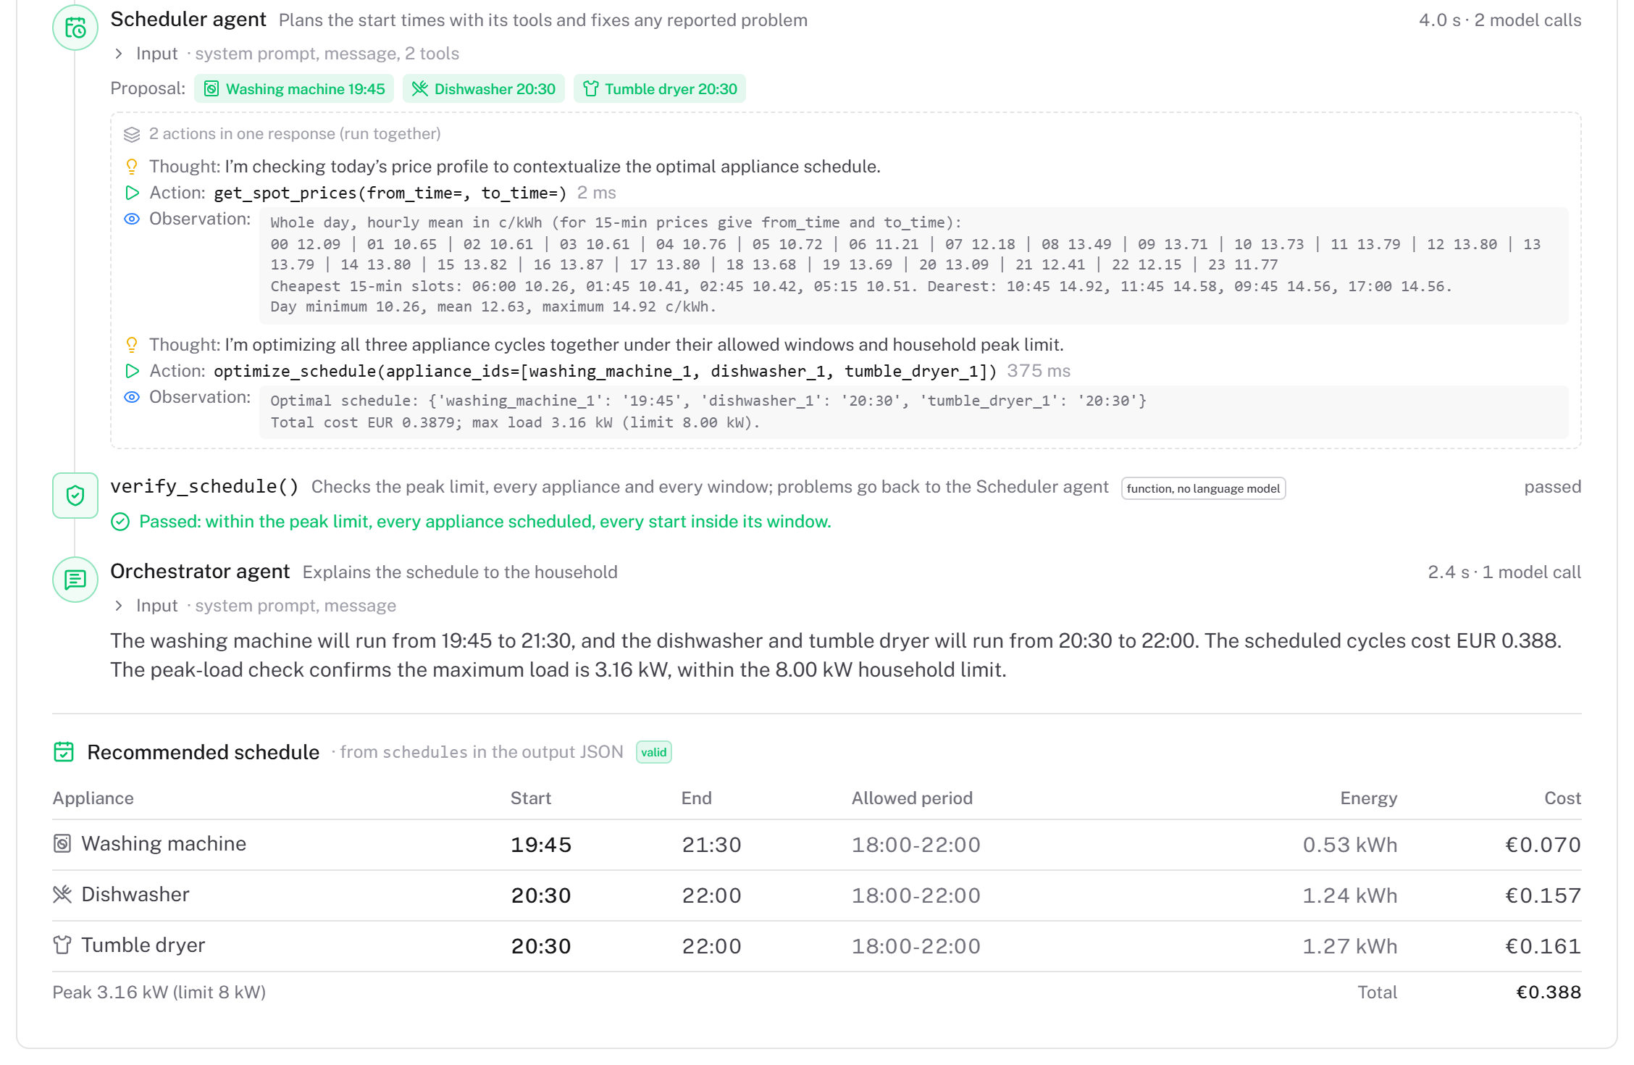
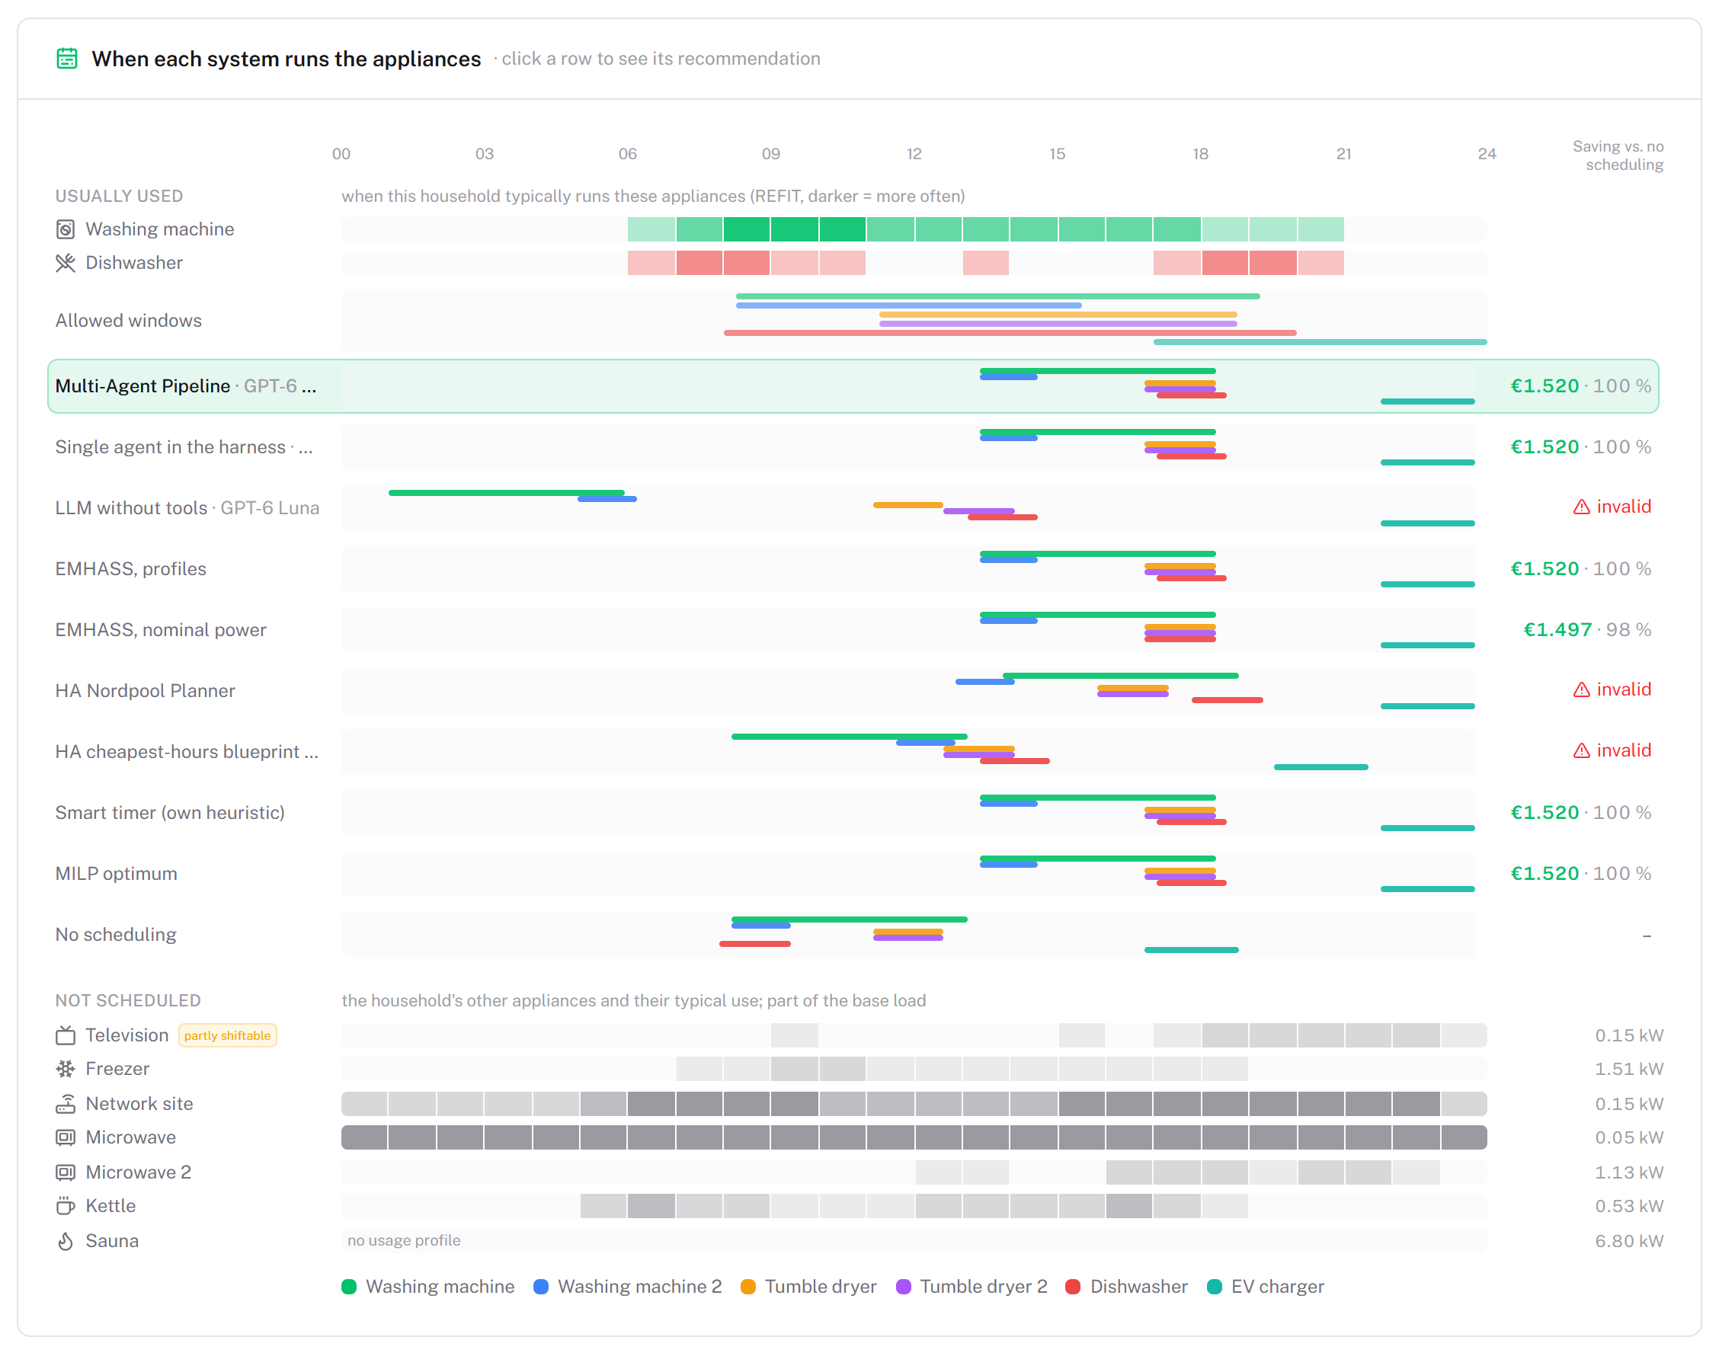
The demo application
Try it: a live run, verified in under 10 s
Replay: one held-out day, every system
hems-demo.lenguyenhanhoan.workers.dev · GPT-6 Luna · today’s Finnish prices from ENTSO-E
Notes:
The artifact is also a web application, shown here in two screenshots. On the left is a live run on the Try it page. A household enters a washing machine, a dishwasher and a tumble dryer that may run in the evening, the demo fetches that day’s Finnish prices, and the pipeline runs with GPT-6 Luna. The trace shows every step: the Scheduler’s thoughts, the price lookup and the optimiser call, the verification passing, and the Orchestrator’s explanation in plain language. Here the washing machine starts at 19:45 and the dishwasher and the dryer at 20:30, for about 39 cents, and the whole run took under ten seconds. On the right is a replay of one held-out day with an electrified load. Each row is a system and each bar an appliance. The pipeline, the single agent, EMHASS and the optimum choose the same schedule and save 1.52 euros, while the Home Assistant rules and the language model alone are marked invalid, because they break a window or the 8 kilowatt limit.

Slide 14
What it means, and what it does not show
Significance
Limitations
An LLM alone is not a reliable scheduler; the same model in the right design is valid, optimal and cheap
The agent’s value is access, not better optimisation: a plain description in, an explained and verified plan out
A reusable pattern for agentic systems with hard constraints
UK appliance data, Finnish prices
Simulated households; recommends only, no device control
Structured requests, not free conversation
8 kW applied as a hard limit per 15-minute slot
Modest savings: at most about €35 a year per household
Takeaway the design, not the model, makes LLM energy advice reliable
Notes:
What does this mean? First, a language model on its own is not a reliable scheduler, but the same model inside the right design is: valid in every run, optimal, and cheap. Second, the agent’s value is not better optimisation, since EMHASS matches it. Its value is access: a household describes its day in plain terms and gets an explained, verified plan without configuring an optimiser. Third, the design principles are a reusable pattern for agentic systems that must respect hard constraints. There are limitations. The appliance data come from UK homes and the prices from Finland. The households are simulated, with no field trial, and the artifact only recommends; it does not switch devices, so the realised saving depends on the household. The requests are structured, not free conversation. The 8 kilowatt threshold is applied as a hard limit per 15-minute slot. And in euros the savings are modest: about 16 percent of what the flexible appliances cost, which for the household with the most to gain is about 35 euros a year at today’s prices.

Slide 15
Let the agents decide and explain, a solver search, and code verify
RQ
SQ1
SQ2
SQ3
Agents in a deterministic harness with an optimiser tool; six design principles
Valid and optimal in every run; 7.4 s and $0.0004 per recommendation
Beats the Home Assistant rules under every pattern and load; equals EMHASS
A second agent adds time and cost, not reliability; one agent suffices
Future work field trial · a device control agent for smart devices · free-text requests · smaller local models
Thank you · Hoan Le · University of Oulu
Notes:
To conclude. The research question asked how to design such a system. My answer: let the agents decide and explain, let a solver search, and let code verify. Sub-question one: the recommendations are valid and optimal, in under ten seconds, for a fraction of a cent. Sub-question two: they beat the Home Assistant rules under every price pattern and load, and they equal EMHASS. Sub-question three: a second agent adds time and cost but no reliability; on these problems one agent is enough. Future work includes a field trial with real households, a device control agent that runs the appliances automatically, requests in free text, and smaller local models. Thank you for watching.

